Slide 1
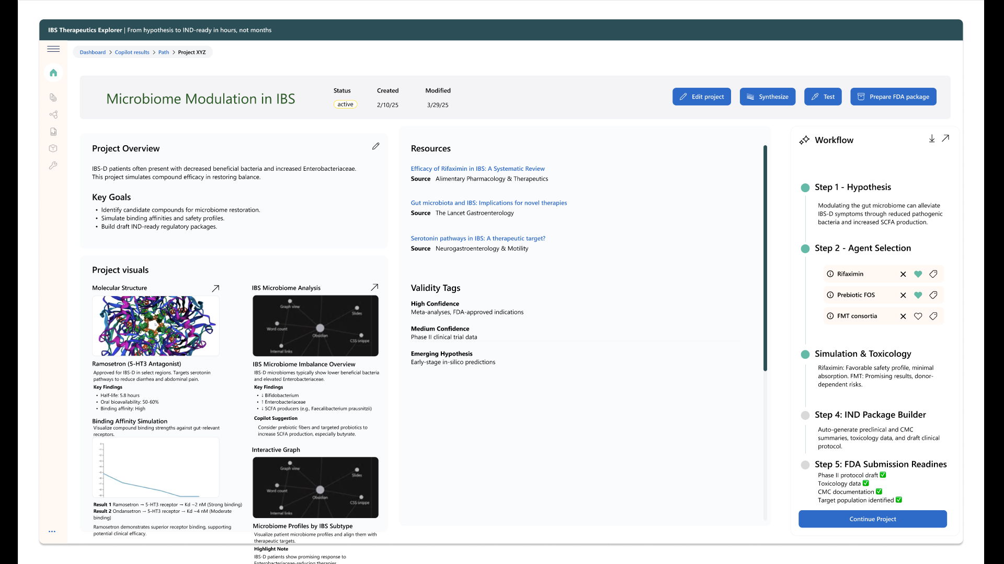
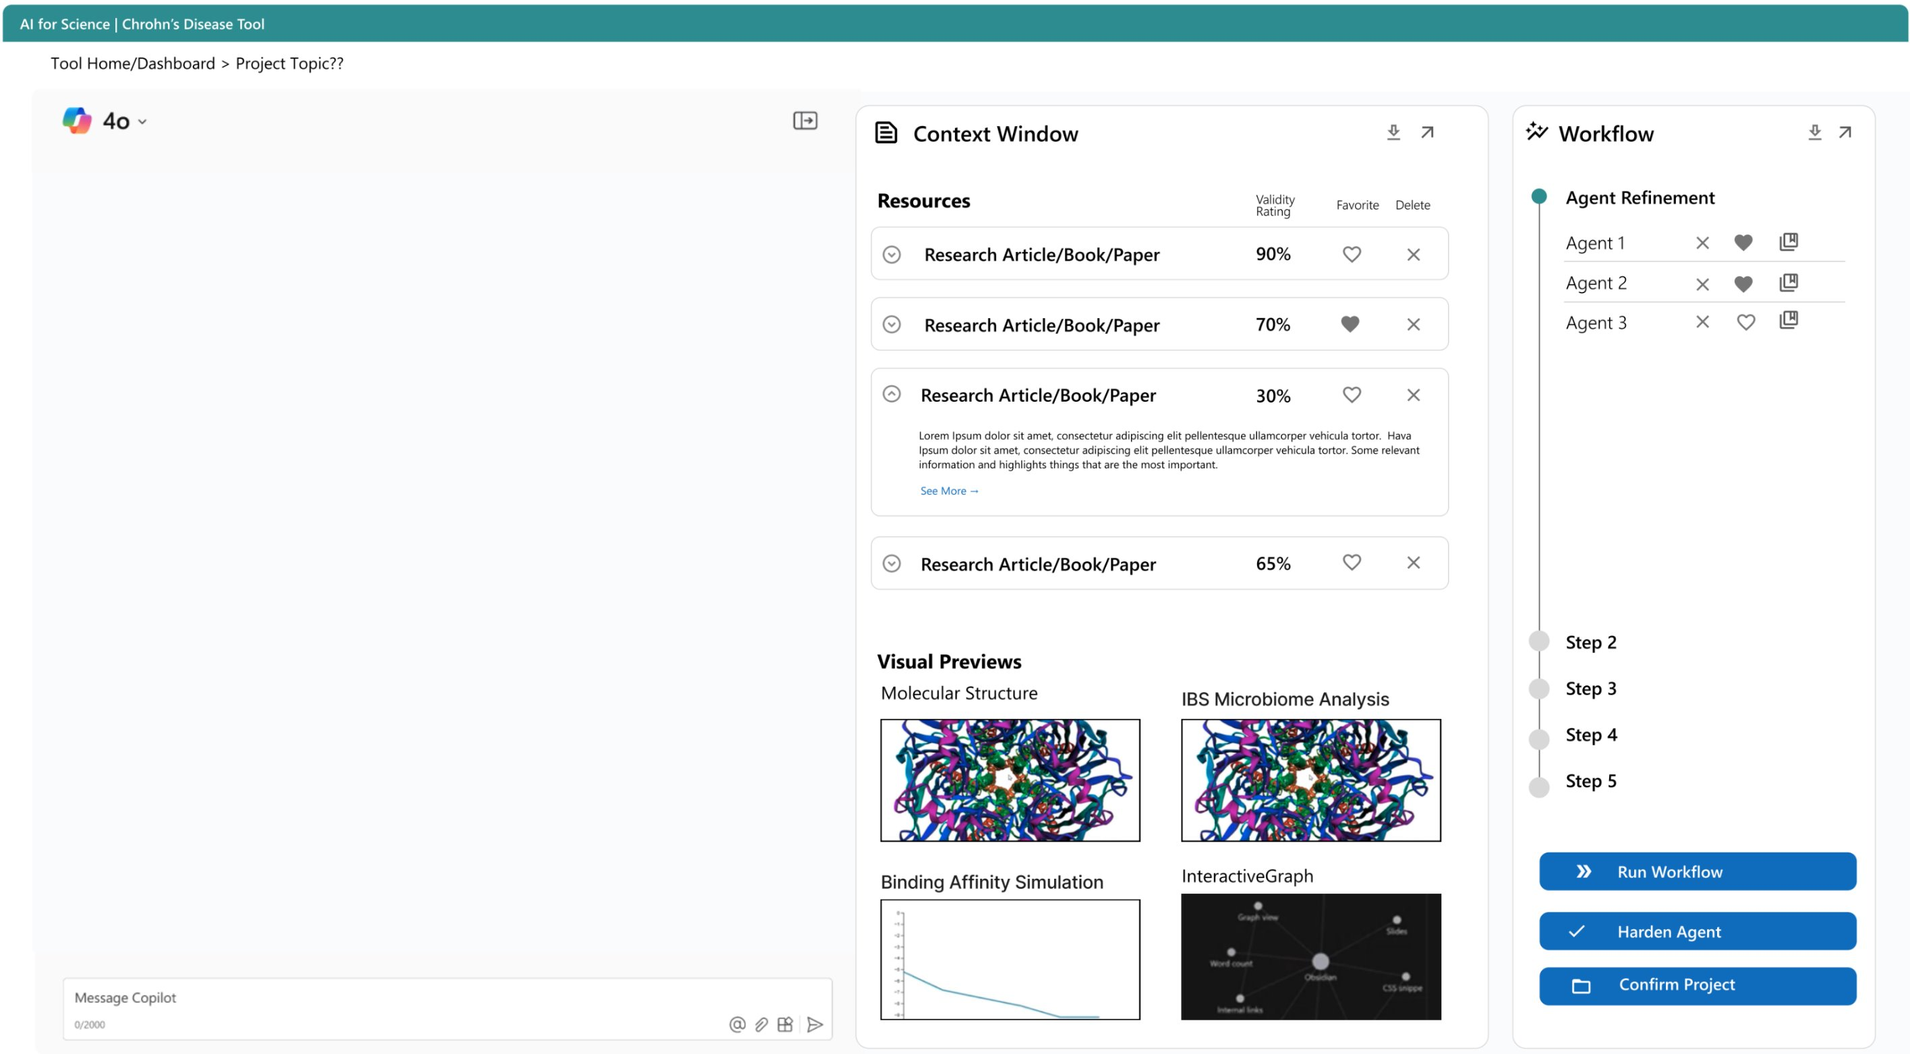
Microsoft – Pharmaceutical AI Agent Demo
Business Need
Microsoft sought to create a proof of concept to help its sellers demonstrate how AI can be applied to complex, regulated pharmaceutical research scenarios. The goal was to showcase how Azure OpenAI could interpret scientific language, automate research and compliance workflows, and reduce time-to-insight across R&D and regulatory operations. By providing a concrete, working example, Microsoft aimed to equip sellers with a compelling narrative and visual demonstration to accelerate customer conversations and drive adoption of AI solutions.
What We Did
Partnered with Microsoft to design and build a proof-of-concept AI research assistant demonstrating advanced pharmaceutical research workflows using Azure OpenAI
Implemented a conversational AI interface capable of understanding scientific terminology and enabling natural-language queries across molecular, clinical, and research datasets
Orchestrated automated AI agents to perform deeper analysis, generate research summaries, and simulate downstream regulatory and documentation workflows
Demonstrated end-to-end research automation, from hypothesis exploration and data analysis to draft regulatory and scientific documentation
Showcased how AI can reduce tool fragmentation by centralizing complex research workflows into a single, AI-driven experience
Results
Demonstrated the potential to reduce FDA submission preparation time by up to 60% through AI-assisted analysis and document generation
Illustrated how AI-driven workflows could accelerate drug discovery cycles by up to 2x, enabled by real-time, conversational access to scientific and clinical data
Showed a projected 30–40% increase in researcher productivity by minimizing manual interpretation, repetitive tasks, and tool switching
Provided Microsoft with a tangible, working example to communicate the art-of-the-possible for Azure OpenAI in regulated, science-driven environments.

